Slide 1


Department of Computer Science and Engineering
CA: Seminar
of
One Month Industry Internship
Session: 2025-26
Organization : ServiceNow
Name: Ayush Mahajan
PRN: 23070521027
Duration : March 2025 – May 2025
Mentors: Industry Supevisors
Symbiosis Institute of Technology, Nagpur Campus (SIT-N)

Slide 2

Presentation Outline:
Introduction of Company (Structure/Information)
Objectives of the
Work Assigned/ Technologies Working
Project Description
Hardware/Software Specification
Methodology
Implementation Results
Internship Completion Certificate
Internship Experience & Learnings

Slide 3
Introduction of Company (Structure/Information)
ServiceNow is a leading cloud-based SaaS platform specializing in digital workflows and IT Service Management (ITSM).
Founded in 2004, headquartered in Santa Clara, California, with a global customer base.
Provides enterprise solutions for ITSM, ITOM, ITBM, HR, and Customer Service management.
Recognized as a top platform for workflow automation and enterprise digital transformation.

Slide 4
Objectives of the Internship
To gain hands-on exposure to the ServiceNow platform and its applications.
To understand ITSM processes in real-world industry scenarios.
To complete the ServiceNow Micro-Certification and Administration Fundamentals training.
To develop skills in workflow automation, platform navigation, and analytics tools.

Slide 5
Work Assigned/ Technologies Working on
Successfully completed ServiceNow Micro-Certification: Welcome to ServiceNow.
Worked on ServiceNow Administration Fundamentals On-Demand course.
Explored modules like Platform Analytics, Service Catalog, and Workflow Studio.
Impersonating [Platform_User] in a simulated environment to perform and validate tasks
Learn about the interface of the environment, learning dashboards, ordering products, placing complaints etc.

Slide 6
Project Description
PROJECT: simulated micro-certification project, involving real-time tasks within a ServiceNow instance.
Covered key areas: Navigation, Lists & Filters, Forms, Dashboards, Reports, Knowledge, and Virtual Agent.
Tasks involved creating and managing reports, dashboards, and service catalog requests.
Designed and executed Visual Task Boards to demonstrate workflow understanding.
Delivered a structured internship log and presentation, documenting tasks and outcomes.
The project centered on hands-on simulator tasks within a ServiceNow learning environment.
Focus was on practical application of ServiceNow features rather than just theoretical learning.

Slide 7
Hardware/Software Specification
Hardware: Laptop with at least Intel i5 Processor, 8GB RAM, and 256GB SSD.
Operating System: Windows 10/11 for smooth compatibility with ServiceNow portals.
Software: Google Chrome / Microsoft Edge browsers for accessing learning modules.
Online Platforms: ServiceNow MyNow Learning Portal and certification environment.
Additional Tools: Stable internet connection and cloud-hosted ServiceNow simulator for practice.

Slide 8
Methodology
UI-Tour, Branding and Customization
Incident, Problem and Change Management
Service Requests
Reports and Dashboards
CI relationships and dependency view

Slide 9
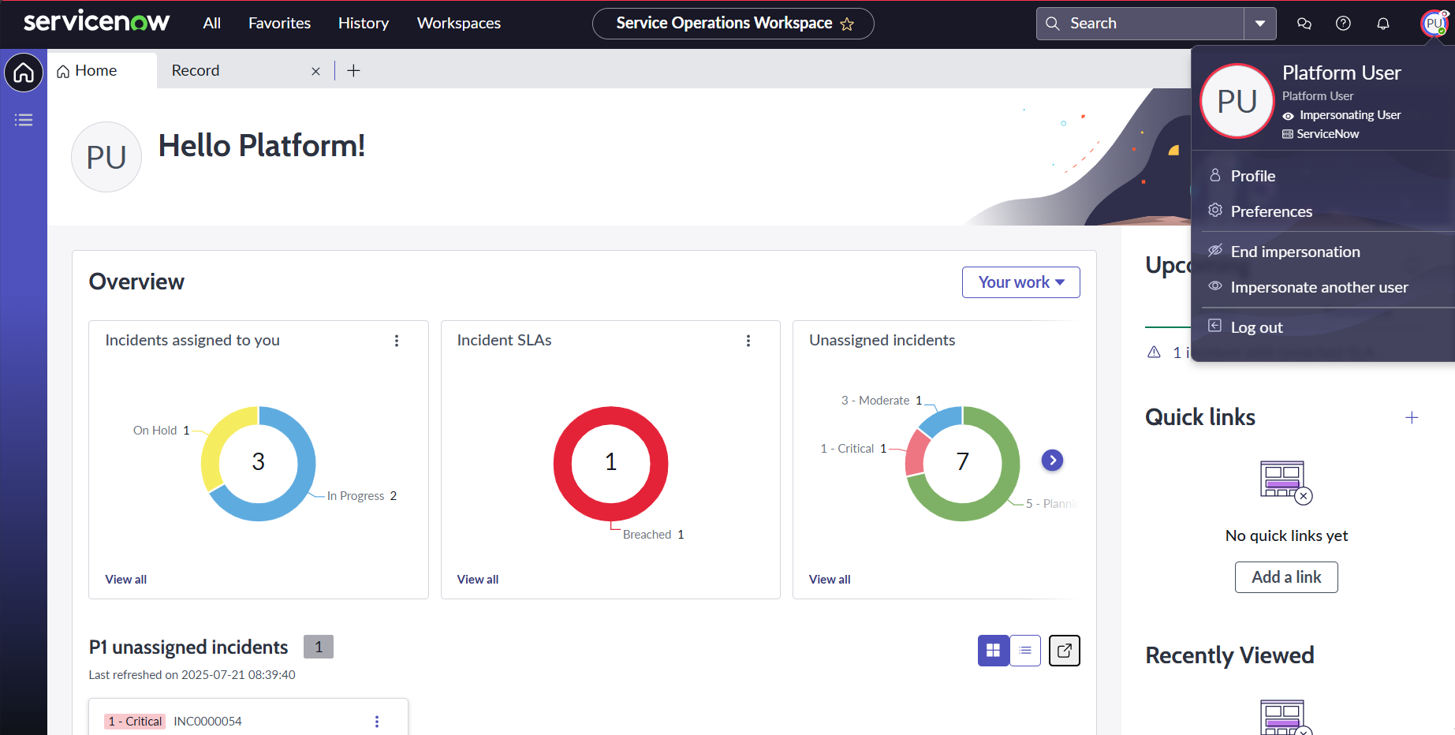
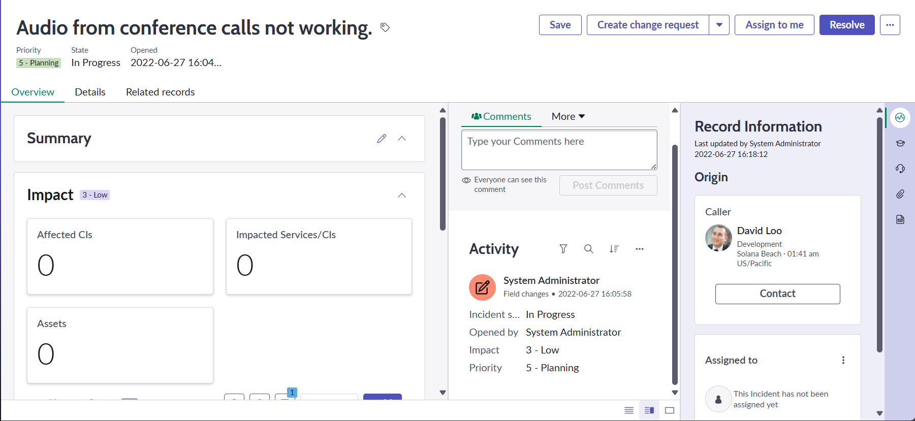
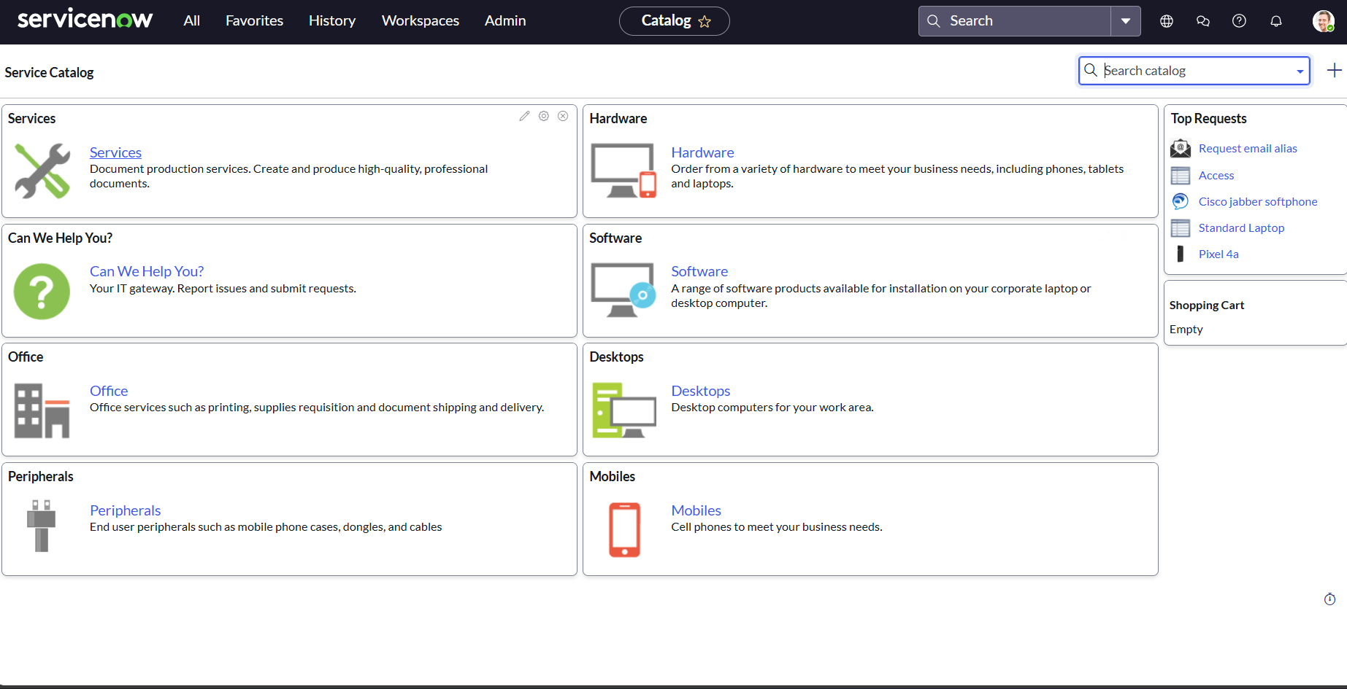
Implementation Results
Impersonating User
Making of Dashboards
Checkout items using service catalogue

Slide 10
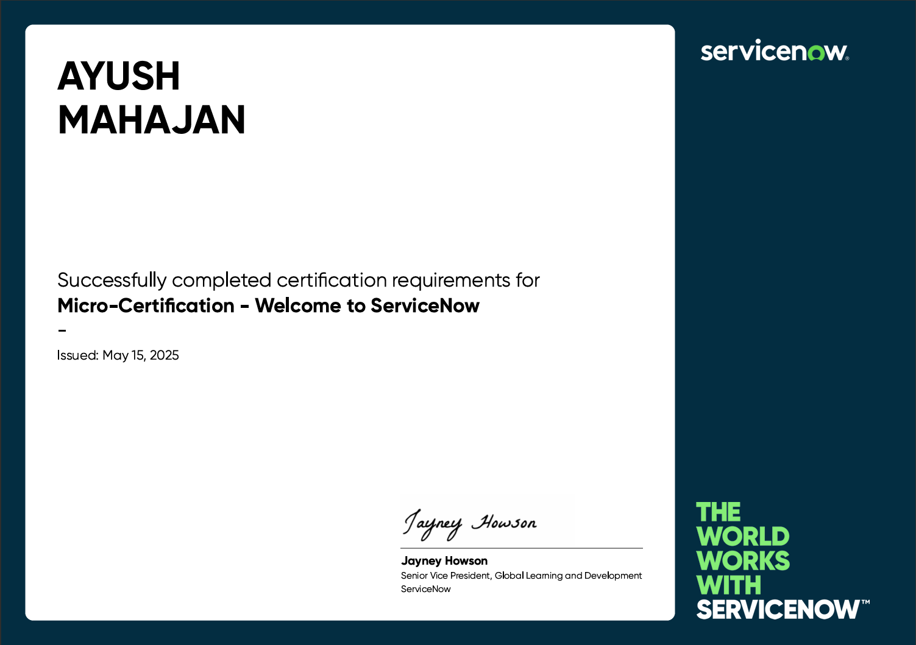
Internship Completion Certificate

Slide 11
Internship Experience and Learnings
Gained hands-on experience with the ServiceNow platform, strengthening technical skills.
Built a clear understanding of ITSM processes, including incident and request handling.
Learned to personalize dashboards, create reports, and manage workflows in ServiceNow.
Improved analytical and problem-solving skills by completing simulator tasks.
Understood the importance of workflow automation, CMDB accuracy, and digital transformation.
Developed professional discipline through structured e-learning, task logging, and reporting.

Slide 12
Thank You…..

